Slide 1
Game Design Assignment 2.1
Tan Yan Jun
2004912H P01

Slide 2
Introduction
All over Different Sekai is a mobile action RPG dimension game, set into 2 different dimension.
Izzuka Sekai(set in the 16th century)
Modern Sekai(set in the 21st century)
Player will be controlling a young prince of Izzuka Wajio named Anzu as he progress the story through being teleported to the Modern Sekai by the Wanderer named Alpha.The start of this story is set at Izzuka Sekai,where it is full of traditional Japanese home and fashion.
As he teleport to the Modern Sekai,he meet a few different allies from all over different dimension.His main objective is to stop the Wanderer Alpha from causing havoc all over different dimension.

Slide 3
Target Audience
All over Different Sekai is target to young people and those who like to see many different kinds of dimension in the game.
Reason why isekai is popular is that people love to be transported to another world while empathizing with the main protagonist which make the game more attract to people

Slide 4
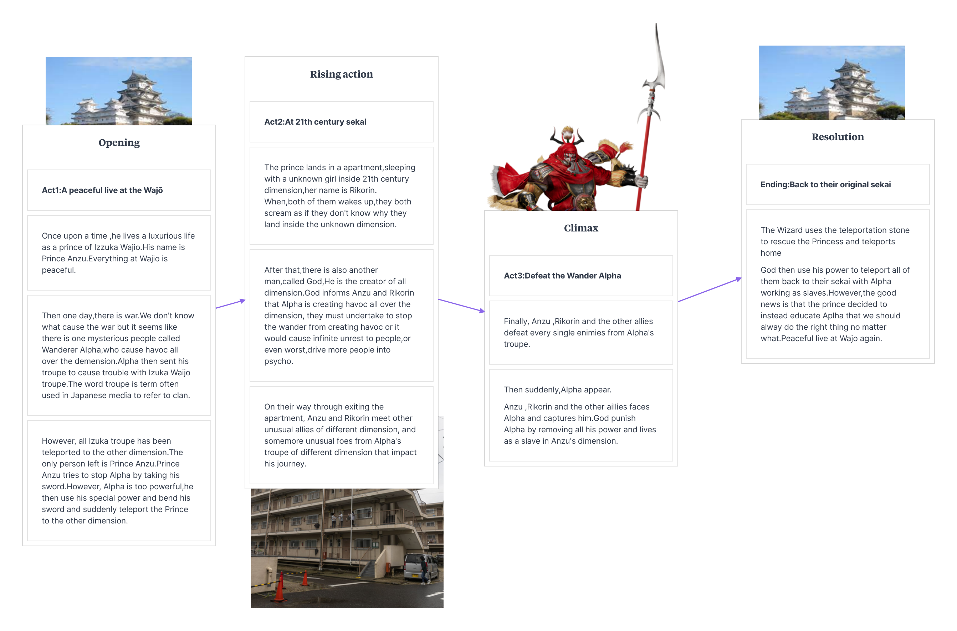
Story of All over Different Sekai

Slide 5
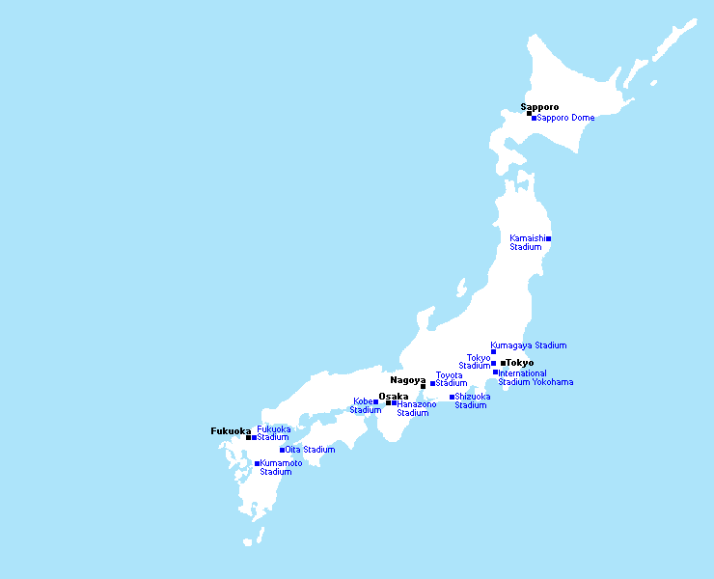
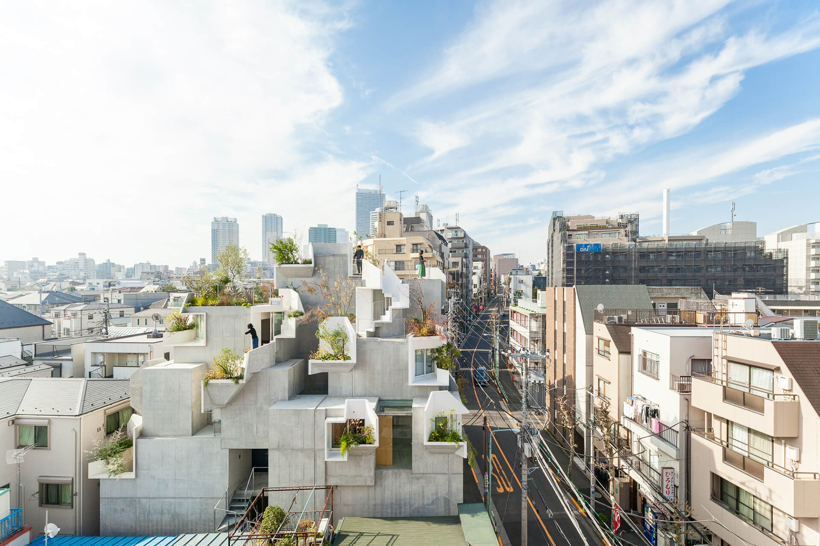
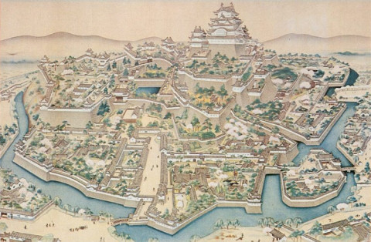
World Map of All over Different Sekai
End:Modern Sekai(set in the 21th century)
Start: Izzuka Sekai(set in the 16th century)

Slide 6
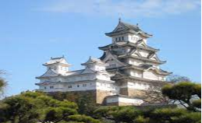
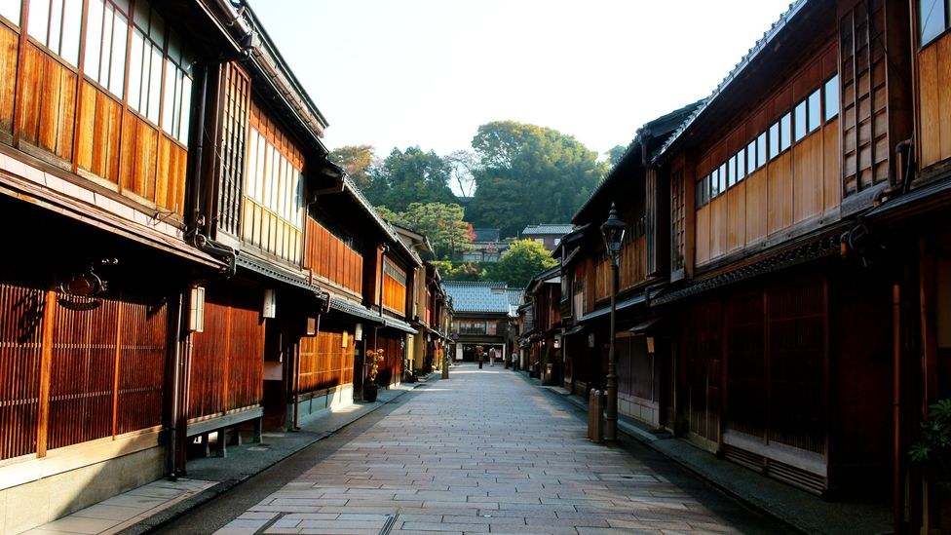
Breakdown of Izzuka Sekai
Izzuka Sekai home to the place where it is full of village and wajo.
Traditional Sekai has 2 sub-theme, the prince, Anzu starts the story from Izzuka Wajo where he lives and progresses through Izzuka village where the local villager lives
Izzuka Village
Izzuka Wajo

Slide 7
Izzuka Wajo
The player will start the story here as a prince living a peaceful live.
The player will then interact with his troupe in order to improve himself on his fighting skills
As such, player will retrieve his starter weapon for this part by training with is troupe.
As the player starts training with his troupe ,there is a large commotion about his other troupe being teleported or even start war.
Player’s objective for this dimension will be stopping the enemies from being teleported to another dimension or prevent from further war.
The player has to eliminate all enemies for this level and escape Izzuka Wajo before going to the next destination(village)

Slide 8
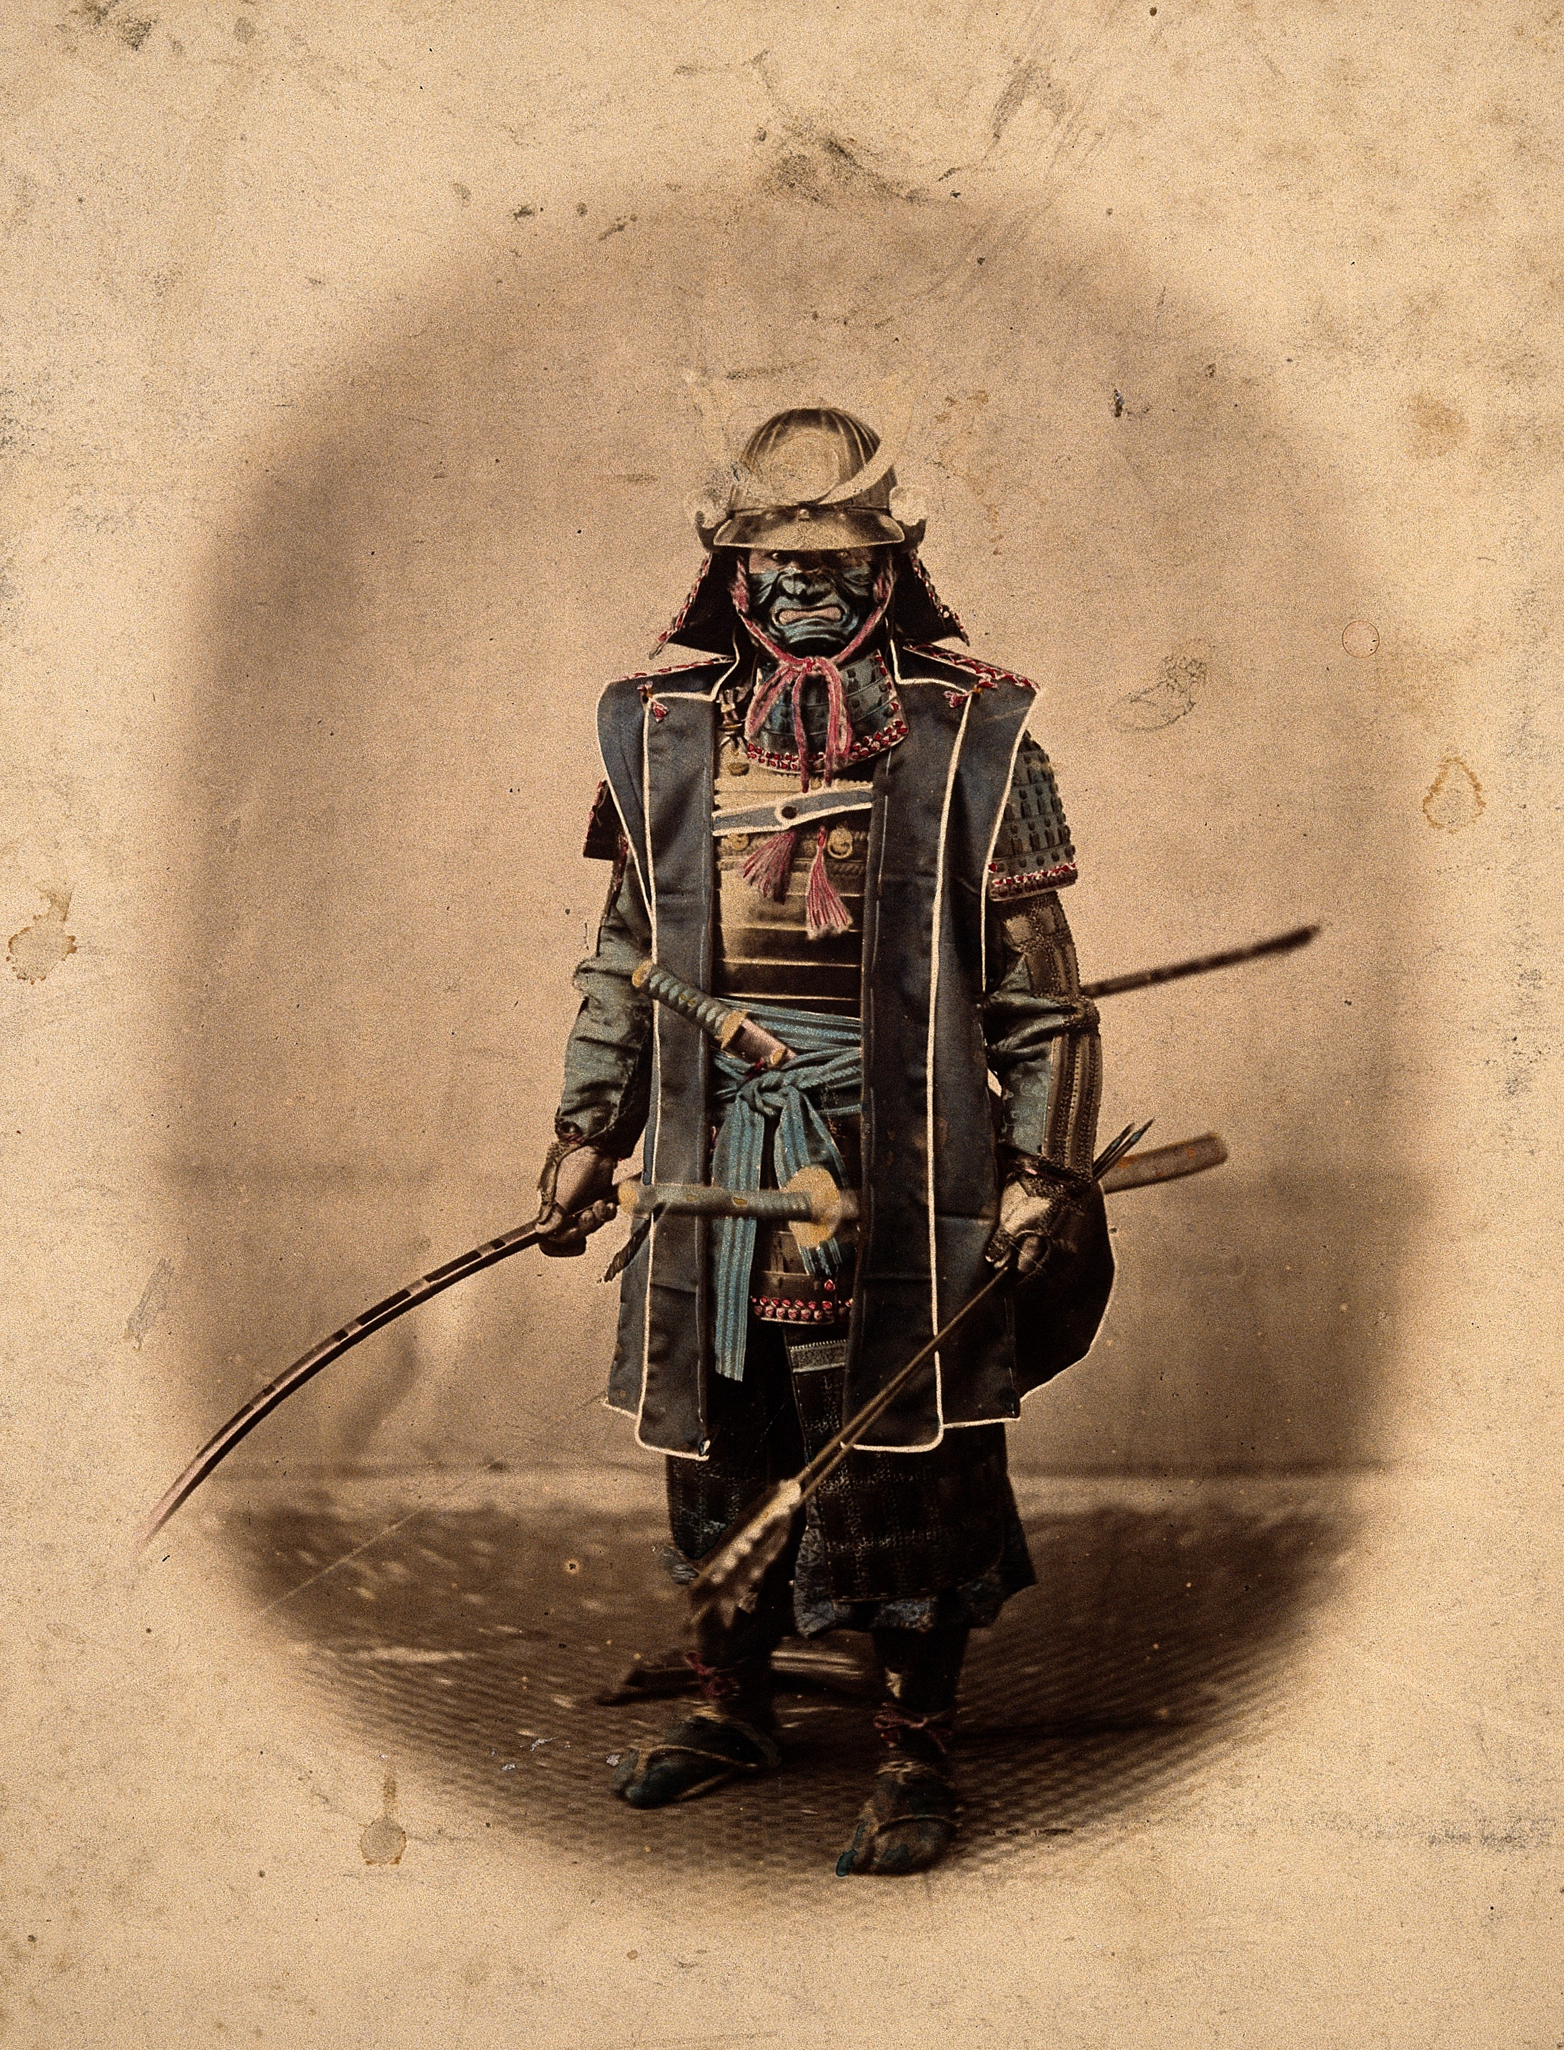
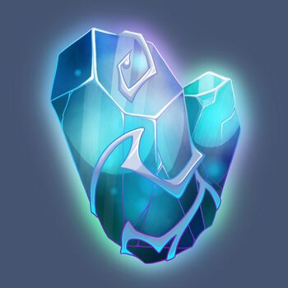
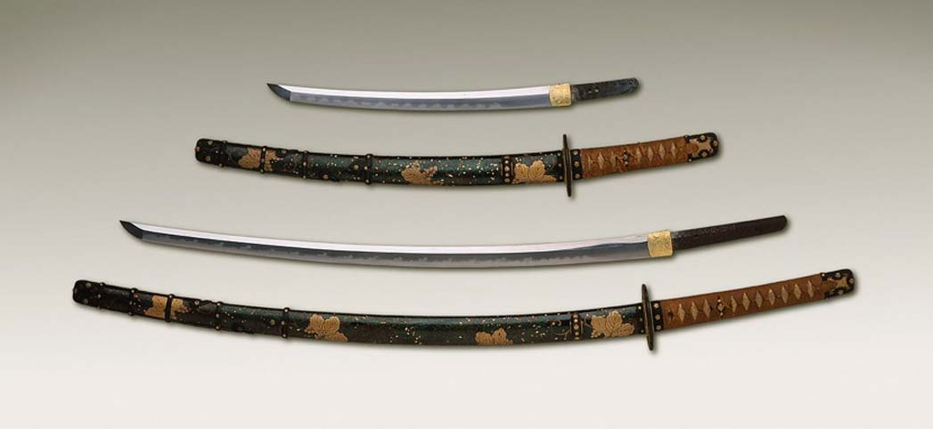
Izzuka Wajo(Enemies)
Alpha’s 16th century
Japanese soilder
Izzuka Wajo will feature Japanese soldier dressed like a samurai for the enemies.
Enemies will hold katana sword and teleporting stone as weapon

Slide 9
Izzuka Village
After player has eliminate all enemies and has escape from Izzuka wajio,he will then go to the village ,to find out that the village people has also been teleported away to another dimension and taken over by the enemies.
Player will also face Wander Alpha who is the main boss of his troupe where he wander everywhere around the village.
Player will then need to strategize to stop Alpha from causing havoc
Player do not need to kill the enemies bust must stay out alive in the village
However, the Alpha is scripted to win against Anzu. Anzu’s defeat and subsequent teleportation to another dimension (Modern Sekai) is the beginning of the story.

Slide 10
Izzuka Village(Enemies)
Alpha’s 16th century
Japanese soilder
Izzuka village will also feature Japanese soldier dressed like a samurai for the enemies. However, their sword skill is better so the player will need to level up themselves.
However, the enemies in the village only hold katana sword

Slide 11
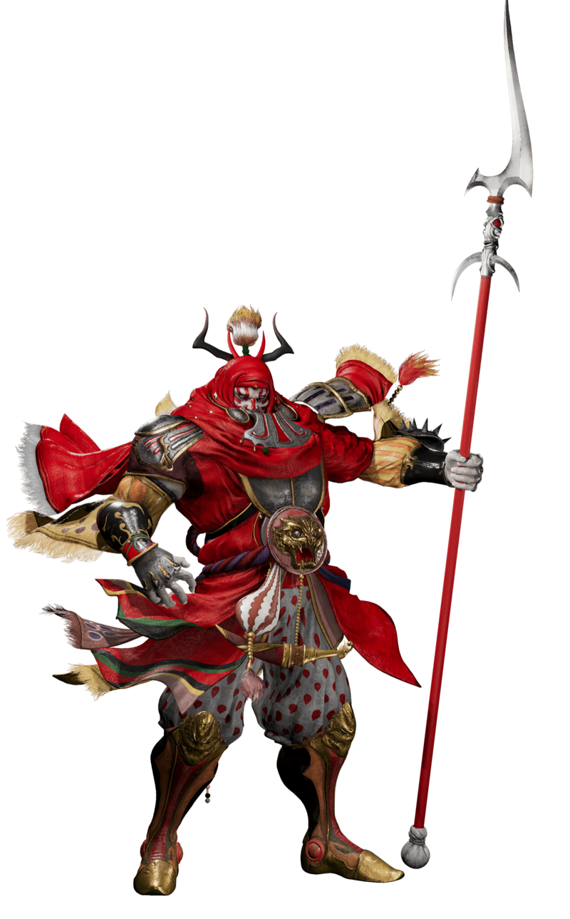
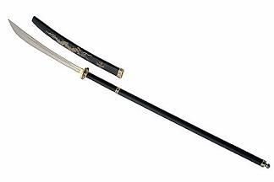
Izzuka Village(Boss)
Wanderer Alpha
Wanderer Alpha will also be dress as samurai but with stronger health ,amour and weapon
Japanese naginata spear

Slide 12
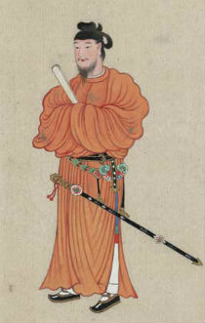
Prince Anzu(Player) in Izzuka Sekai
Prince Anzu
Prince Anzu feature orange kimono
The weapon hold for this dimension is his sword

Slide 13
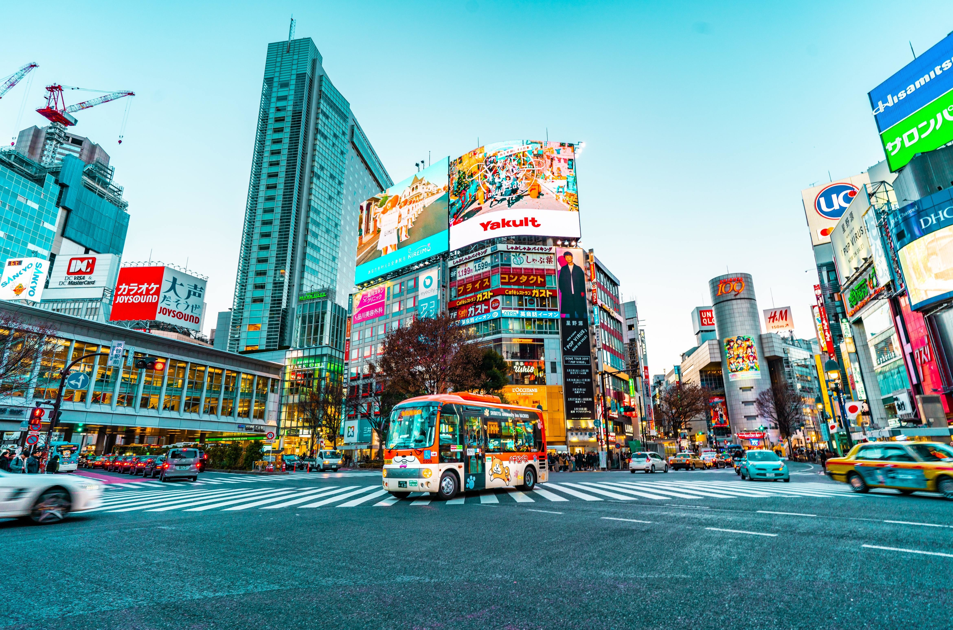
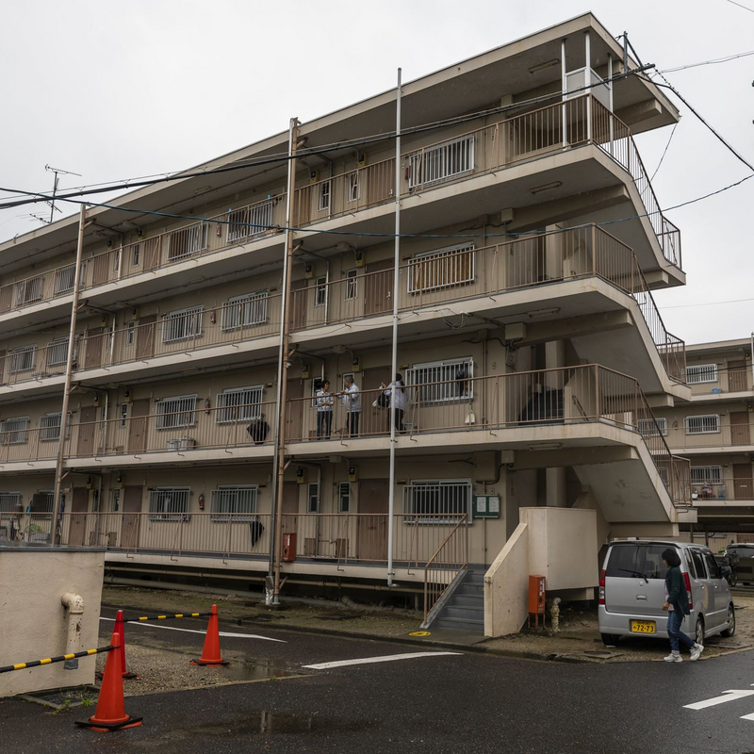
Breakdown of Modern Sekai
Modern Sekai is full of cities at the back and apartment where people live at the front.
Apartment Area
Modern Sekai also has 2 sub-theme, the prince, Anzu is teleported to the with a new ally from another dimension and progresses through with meeting more allies at the city area
City

Slide 14
Apartment Area
The player is then teleported to the apartment where he sleep with the unknown ally, Rikorin
The player will also meet the God who is the creator of all dimension
The player will have no weapon to start with in this dimension since he is teleported without his weapon.
The God also hints to Anzu and Rikorin that the havoc caused by Wanderer Alpha is still ongoing and it is hapening in this same 21st century dimension as Anzu.
As the exit the apartment, Anzu and Rkorin then saw a group of enemies causing trouble in the neighbourhood and in fact attack them from nowhere.
They will need to run away from the enemies and escape to the city area where they meet another new bunch of allies since they have no weapon to use before being killed by the enemies.

Slide 15
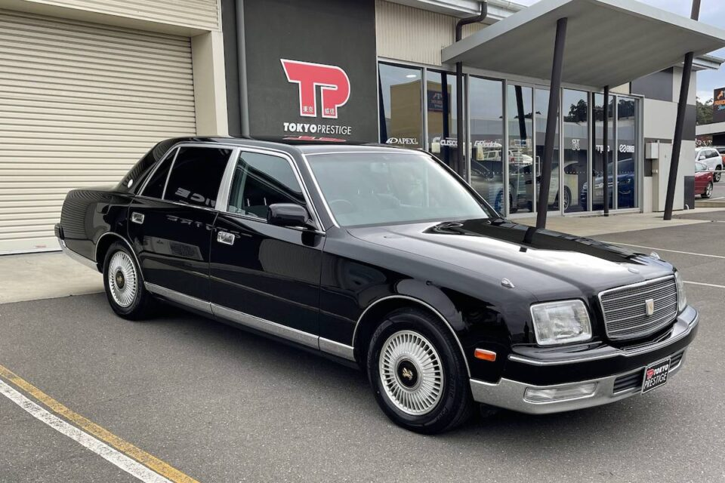
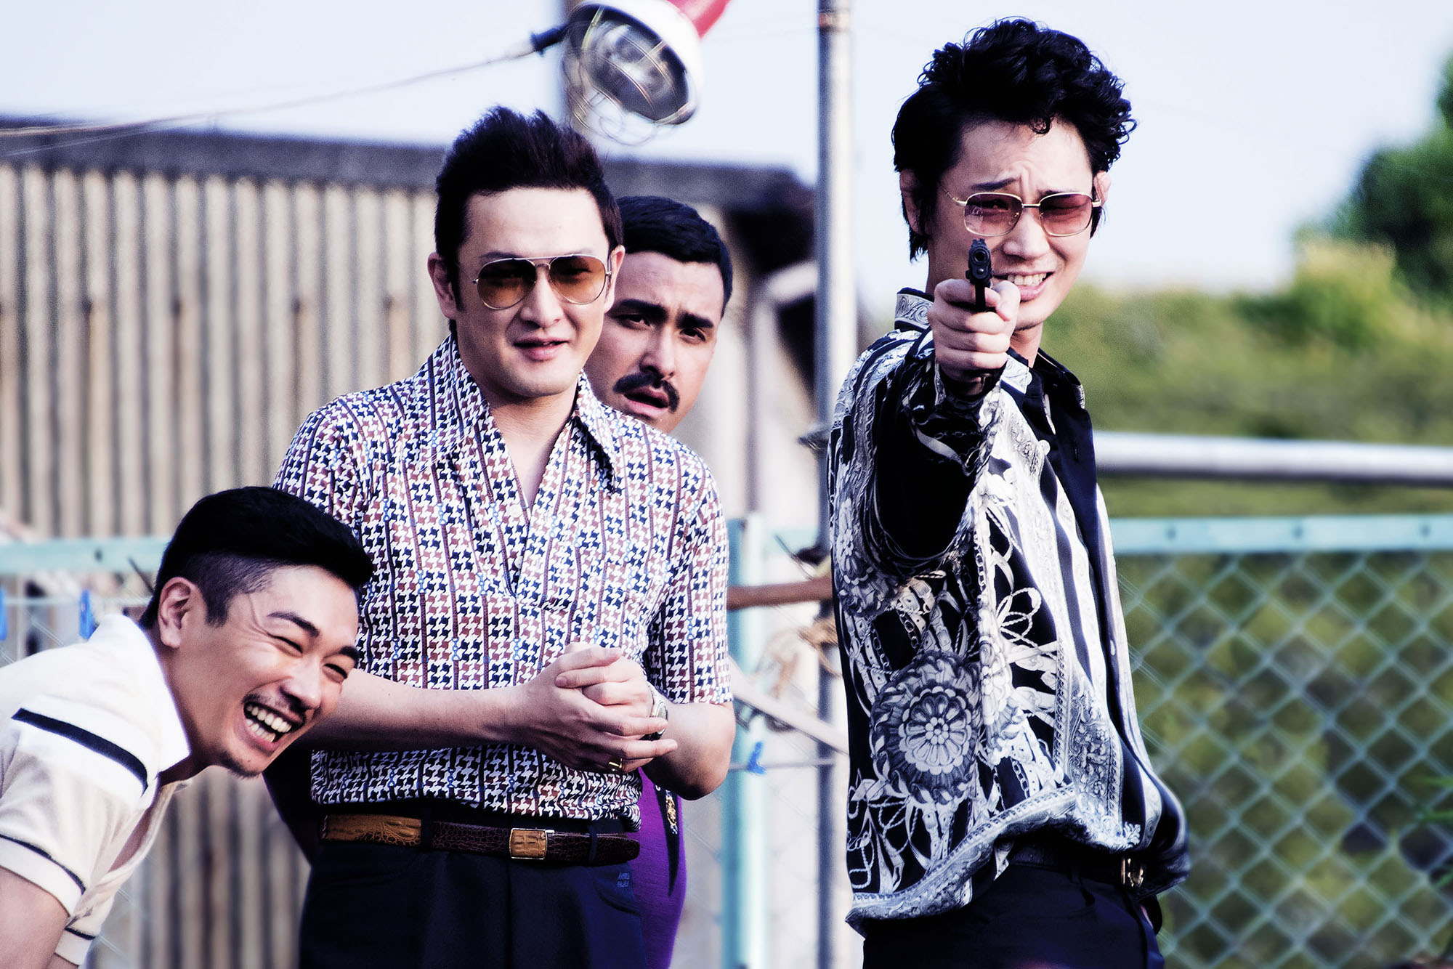
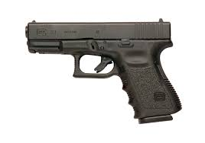
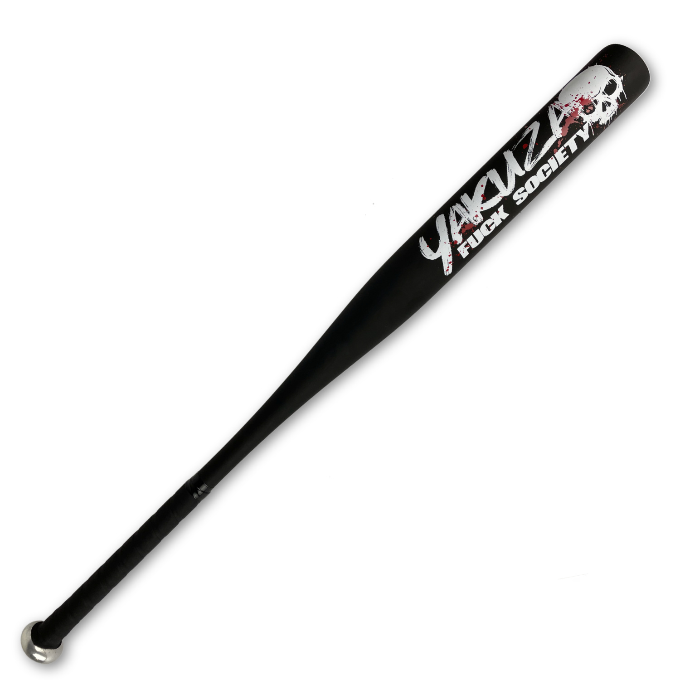
Apartment Area(Enemies)
This vehicle is also used for yazuka to chase after the allies
Alpha’s 21st century
yakuza
Enemies will hold gun and baseball bat as weapon
This enemies feature a group of yakuza who is also part of Alpha’s troupe

Slide 16
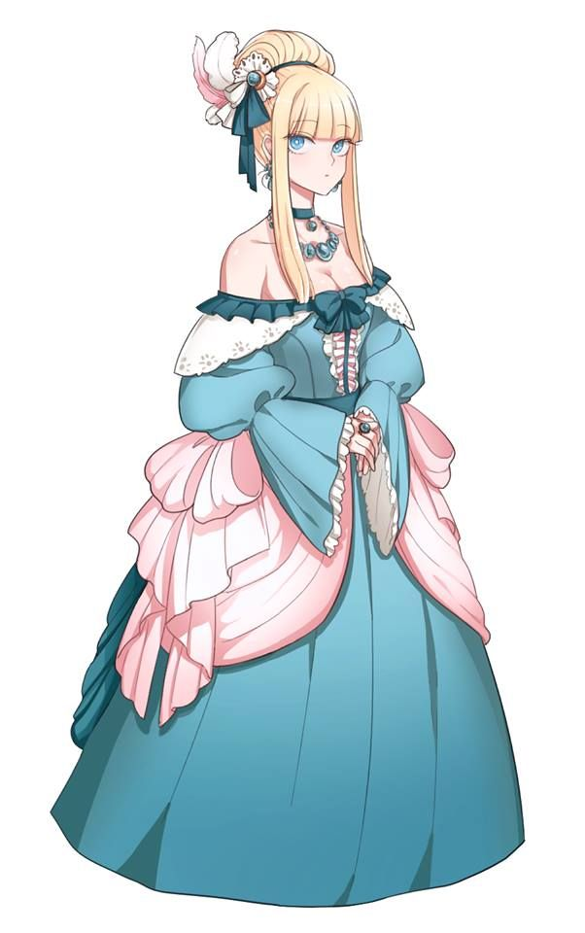
Apartment Area(Ally)
This vehicle is also used where the car similar to the yakuza is stolen by the player and allies to run away from the yakuza
Princess Rikorin
No weapon is used for this level
Princess Rikorin is based on the Euroseana sekai where it is full of people in European clothing with European fine dining and it is not playable sekai in the game

Slide 17
City
When Anzu and Rikorin escape to city area,they meet another allies named,Alexander from future dimension called Cyber Sekai
Alexander has been surrounded by the enemies originated by Cyber Sekai
Anzu and Rikorin are also surrounded by the yakuza
Player will face Wander Alpha again with Rikorin and Alexander
They will need to clear 2 waves of enemies(Yakuza and the enemies from Cyber Sekai) before defeat the boss(Alpha)
Luckily,weapon can used to clear waves of enemies since Alexander throw us some weapon to use it
After defeating 2 waves of enemies, the allies will altogether defeat the boss one last time
If Alpha is defeated,he will be teleported to Izzuka Sekai as slave as punishment from God where the story ends.

Slide 18
City(Wave 1 Enemies)
Alpha’s 21st century
yakuza
Vehicle will not be used for this wave as yakuza will be fighting with weapon after surrounding with car
Enemies will also hold gun and baseball bat as weapon
This enemies still feature a group of yakuza where they surrounded Anzu and Rikorin

Slide 19
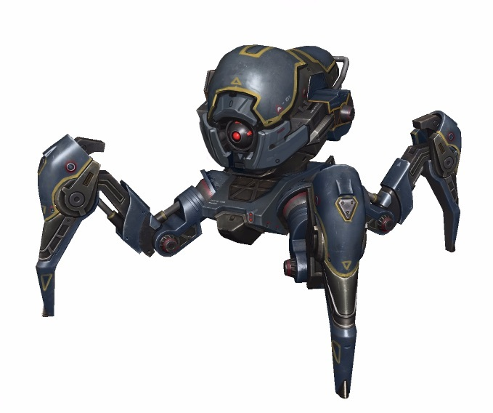
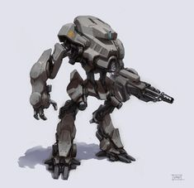
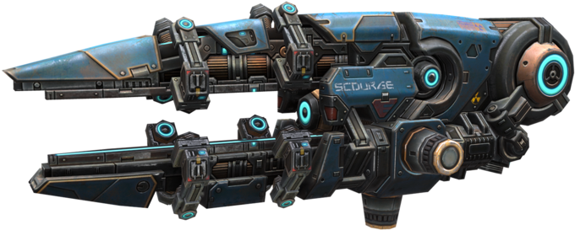

City(Wave 2 Enemies)
Alpha’s Cyber Enemies(Two variant)
After clearing wave1 enemies,player and two other allies will also face enemies that made up of robot with two variants
Enemies will also hold lazer gun and lazer beam as weapon

Slide 20
City(Boss)
Wanderer Alpha
Wanderer Alpha will also be boss again but now with weapons from all troupes

Slide 21
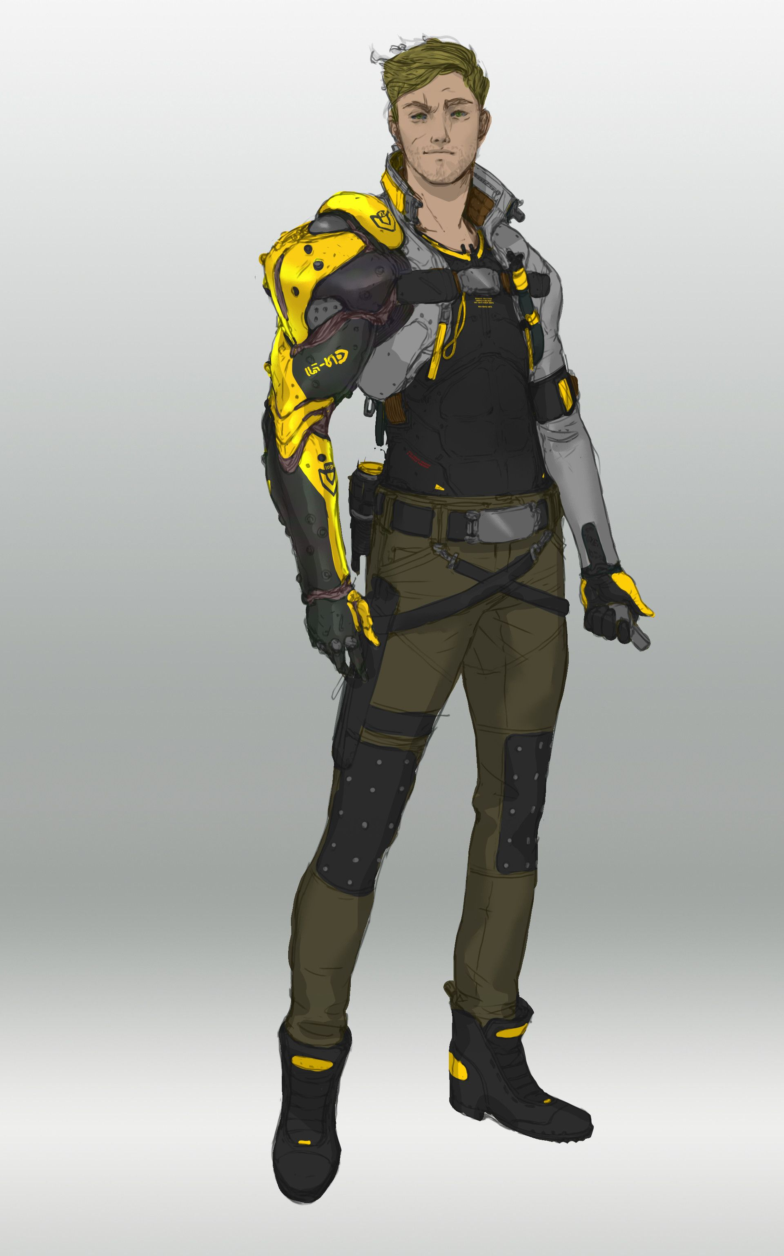
City(Player and allies weapon)
Alexander
Alexander outfit tend to be more futuristic where based on Cyber Sekai,full of futuristic weapon and cities
Player will also hold lazer gun when at wave 1 enemies
More weapons from the yakuza can be used after defeating wave 1 enemies.

Slide 22
Player Progression at Izzuka Sekai
Izzuka Village
This sub-level get a bit harder as the enemies player face is stronger and may have to clear the enemies even their main objective for this sub-level is to stop Alpha from havoc
Izzuka Wajo
Player should be able to familiarize with the controls and the weapon they are using since sub level has tutorial to guide
The player

Slide 23
Player progression of Modern Sekai
Apartment Area
This sub-level will have no weapon so player has to escape yakuza from being captured
A stolen car from yakuza can be used to escape yakuza with the help of Rikorin
This sub-level is the hardest as player will not only have to defeat two wves of enemies but also the boss with all sort of weapon.
By clearing level,allies make use of many different weapon of different sekai(mix of bat and lazer gun)
City

Slide 24
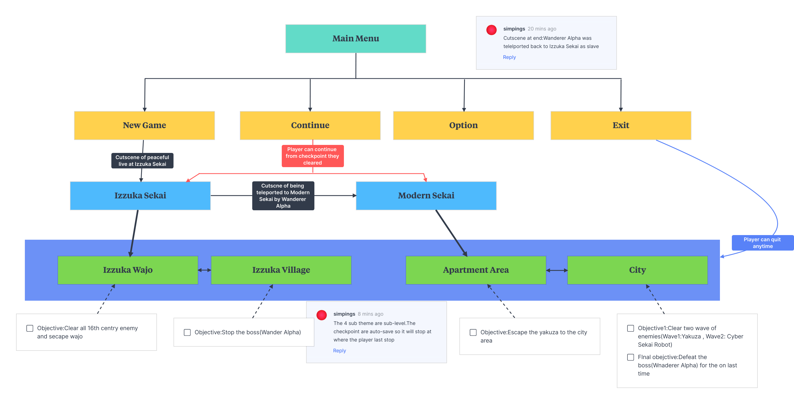
Game Flow of All over the Sekai

Slide 25
Reference
Story of All over the Sekai
https://app.milanote.com/1Pl1PQ1VcbM751?p=LbhMbV2OuzM
Izzuka Wajo
https://no.wikipedia.org/wiki/Himejiborgen
Map of 16th century Sekai
https://www.historytoday.com/archive/japanese-castles
Map of 21st century Sekai
https://www.dezeen.com/2018/05/31/architecture-akihisa-hirata-tokyo-stacks-concrete-boxes-tree-ness-house/
Izzuka Village
https://ychef.files.bbci.co.uk/976x549/p02ls7ym.jpg

Slide 26
Reference
Alpha’s 16th century Japanese solider
https://en.wikipedia.org/wiki/Samurai
Wanderer Alpha
https://www.gematsu.com/2022/10/stranger-of-paradise-final-fantasy-origin-dlc-wanderer-of-the-rift-launch-trailer-details-and-screenshots
21st century Apartment
https://www.wsj.com/articles/fortress-becomes-japans-biggest-private-apartment-landlord-with-1-billion-bet-11560855602
16th century Japanese solider weapon
https://www.ancient-origins.net/artifacts-ancient-technology/samurai-weapons-0010730
Teleporting stone
https://criticalrole.fandom.com/wiki/Gate_stone

Slide 27
Reference
Japanese naginata spear
https://www.stronghold-nation.com/history/ref/japanese-naginata-spear
Yakuza
https://www.japantimes.co.jp/wp-content/uploads/2016/06/p9-hadfield-twisted-20160623.jpg
Small arm pistol
https://cdn.britannica.com/96/176196-050-EFC5E6A6/Glock-pistol.jpg
Yakuza bat
https://www.yakuzastore.com/amp-baseball-bat/accessoires/diverses/a-9914/
Yakuza Car
https://www.dmarge.com/wp-content/uploads/2021/02/toyota-century-feature.jpg

Slide 28
Reference
Princess Rikorin
https://i.pinimg.com/originals/44/52/90/4452907bd8b8380520837f96f09c1ba5.jpg
World Map of Japan
https://www.japan-guide.com/g18/rugbyworldcup_1807.gif
City area of Tokyo
https://assets.weforum.org/article/image/responsive_big_webp_3njKlgxuIgM1RPriBxovvZa2lsoUiW1fmg5X0bteJo8.webp
Futuristic Android Allies
https://i.pinimg.com/originals/8a/02/bb/8a02bbd709436aa07be2c4c1e732db28.jpg
Futuristic Enemies 1
https://api.warrobots.net/storage/content/pictures/297/content_invader.jpg
Futuristic Enemies 2
https://i.pinimg.com/236x/14/a5/8b/14a58b4cf74cd5eb5b1f0863a186ab67--scifi-robot-factory.jpg

Slide 29
Reference
Lazer Beam
https://www.pngitem.com/pimgs/m/162-1625645_transparent-laser-sprite-laser-beam-sprite-png-png.png
Robot Shooting Gun
https://www.pngitem.com/middle/xxTTob_war-robots-guns-hd-png-download/
Game Flow of All over the Sekai
https://app.milanote.com/1PlFPz1OSjL53c?p=IwRdG5jOGyw
How Isekai Became Anime’s Most Popular Genre
https://gamerant.com/how-isekai-genre-became-so-popular/#:~:text=People%20love%20to%20be%20transported,world%20with%20a%20fresh%20perspective.

